Slide 1
Banksy Street Art (A new NFT Concept)
By Anthony Franco, Jason Souffront and Nick Mescain

Slide 2
Purpose & Scope
If you've ever imagined finding your own way to disrupt a global industry, or even merely felt an aching urge to get ahead of the next biggest trend, then look no further than the newest and coolest of upcoming movements in the entire metaverse – Digital Street Art!
We have sample surveyed a wide range of feedback over the last few weeks and strongly feel we have observed enough of the open metaverse to confidently ascertain the kind of fresh and provocative asset that the NFT marketplace is missing.
Our intent is to launch a crowdfund sale that will allow for fungible token returns to donors willing to contribute their hard earned Ether to the development of a new NFT concept that we know will be groundbreaking – Banksy gone DIGITAL!
We believe the development and mass distribution of this exchangeable asset (as an NFT class) has the capacity to evoke the kind of political, cultural, intellectual and even emphatic focus upon the deepest and most intrinsic aspects of the human condition.

Slide 3
A Brief Backstory
Growing up in the city, it was almost impossible not to notice the vapidly growing cultural movements spanning what we commonly refer to today as “Street Art”
Many partaking in this movement are in it for the fun and freeform expression, while others see it as opportunity to rebel or even disturb the peace.
Regardless of the “why” – nearly none among them have had as profound and lasting an impact as the undeclared mastermind known as Banksy
To reflect on the appreciation and gratitude we have for this unkown artists’ incredible contributions to mankind, we’ve decided to develop a crowdfunding initiative to bring their art to the front of yet another of the most disruptive facets of modern life…the ever rapidly evolving digital metaverse!

Slide 4
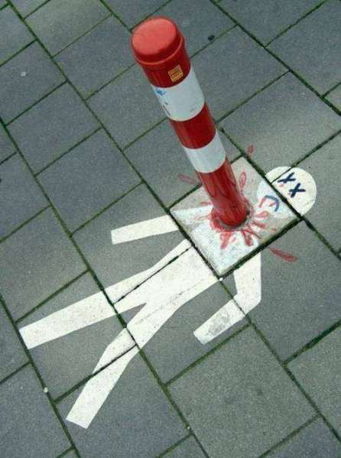
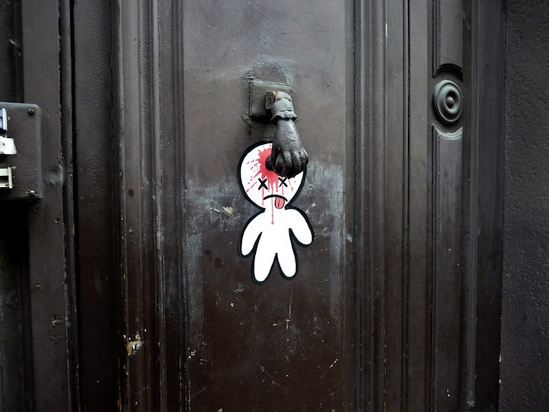
But we need your help!
There are 30+ years worth of Banksy street art out there so without you…our company cannot upkeep the manpower, time and other resources essential to getting a creative endeavor of this magnitude off the ground.

Slide 5
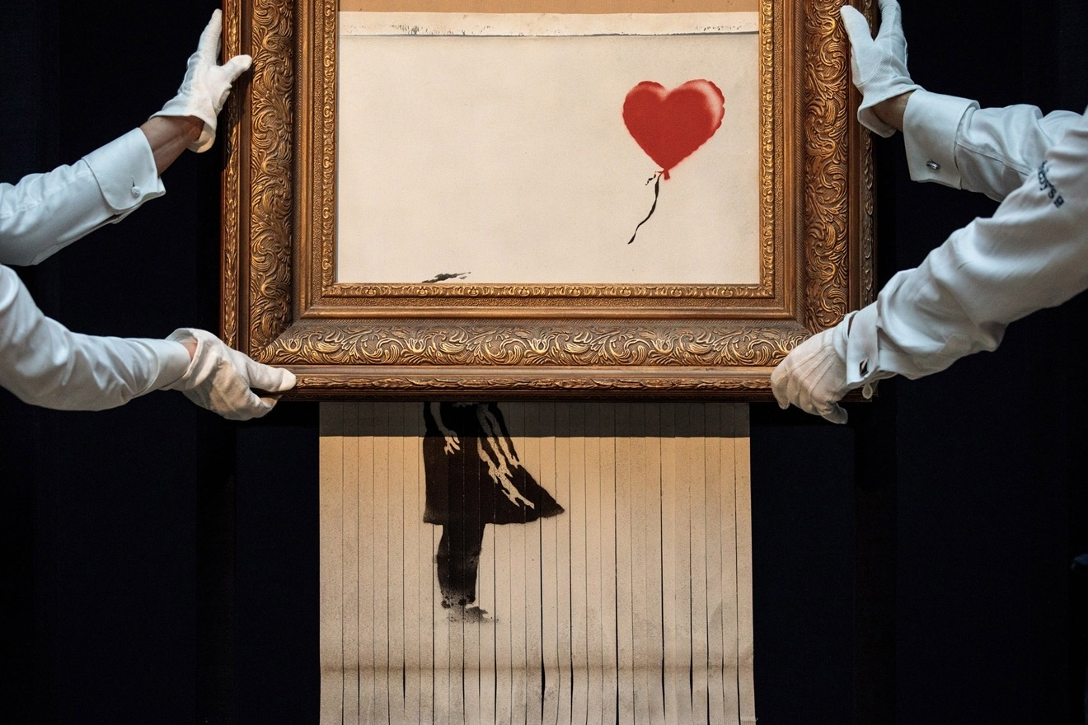
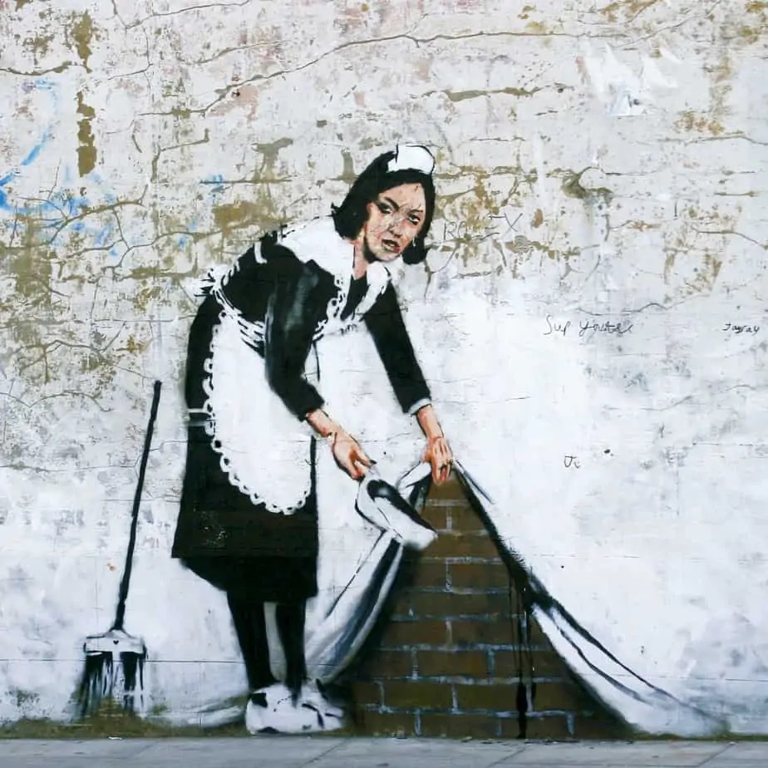
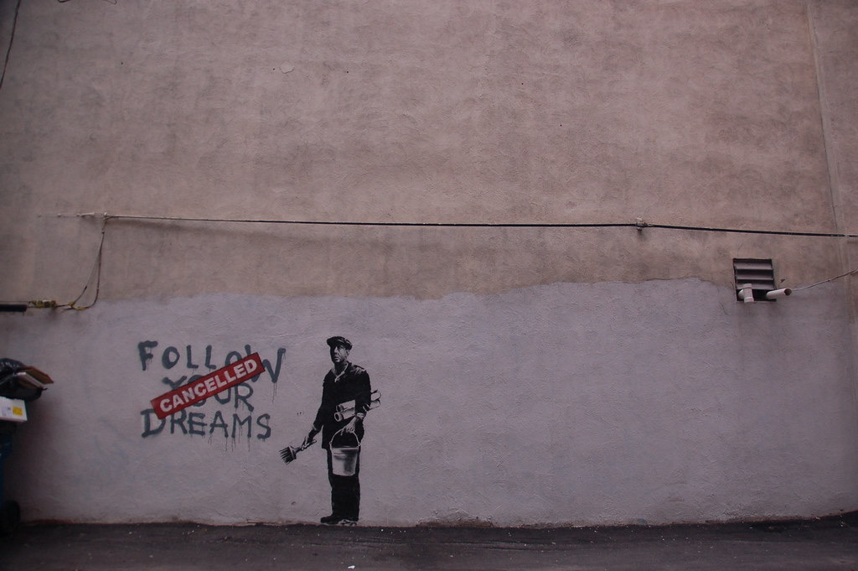
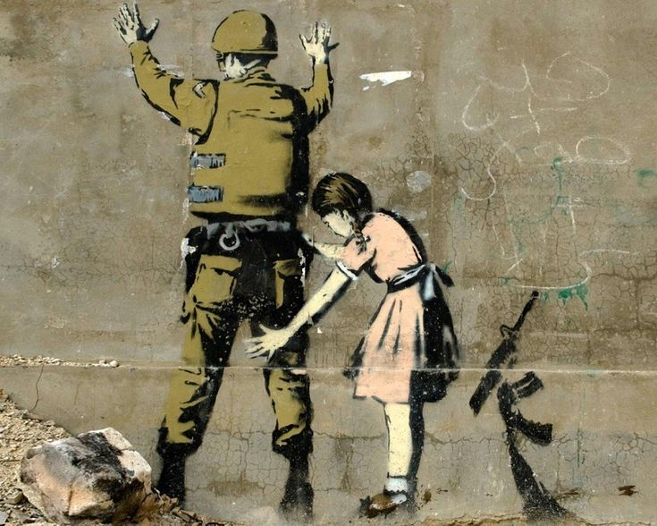
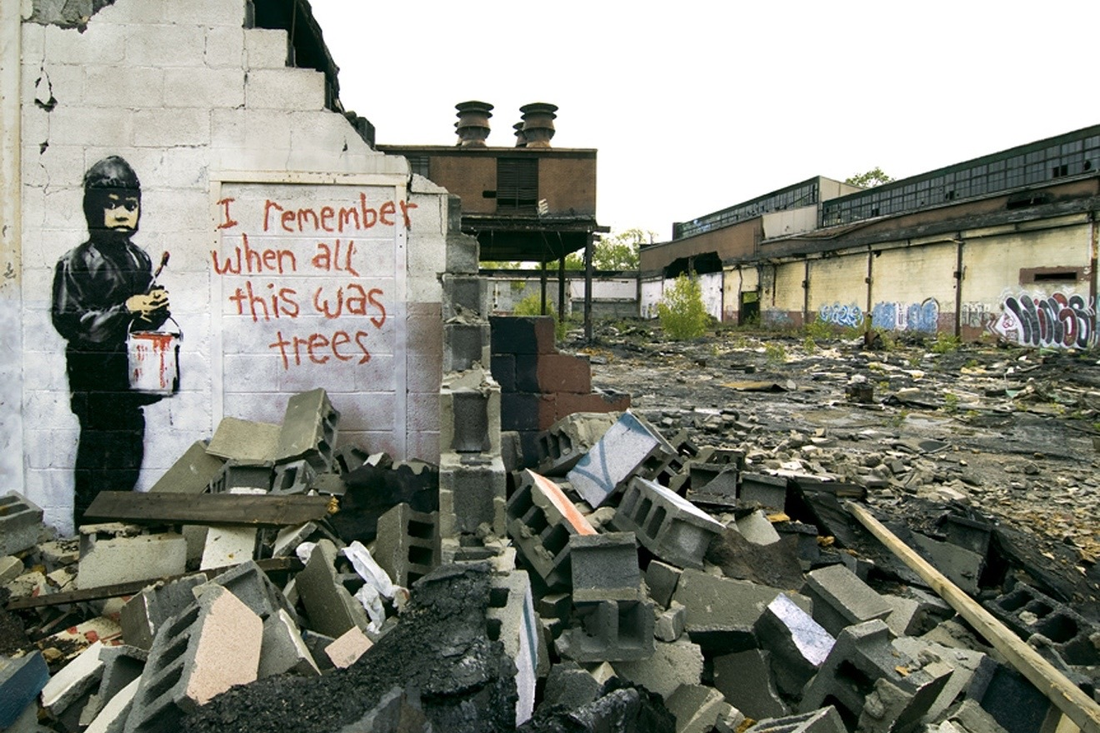
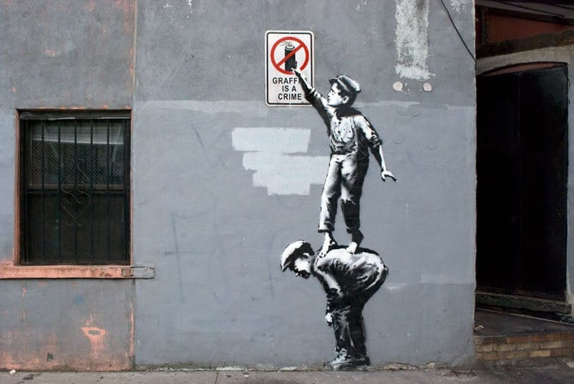
Sample Sheet
Letting Go
The Rich and the Dastardly
A Tweet via “COVID-19”
Meandering Grace
The Domino De Facto
Kids These Days

Slide 6
Crowdfund Donor Perks
Donate at least 1,000,000 Wei to the crowdfund today will qualify you to enter a pool to win up to 5 extra NFT assets (quality TBD) upon your first purchase
Donate at least 5,000,000 Wei to the crowdfund within the next 15 days and we will match the value of your first purchase on go-live (giving you a buy one, get any other - of the same quality - free!
Donate at least 10,000,000 Wei to the crowdfund within the next month and we will reserve any one first edition of your choice for up to 6 more months at 25% standard market rate (limited to 45% standard rate for tier 4 quality and higher)

Slide 7
Future Business Model and Considerations
Tier-Based Quality Assurance (In Development)
Stay tuned on this!
Assuming we meet our goal of 5,000 Ether within the next 8 months, we intend to onboard a series of professional assessors (and their portfolio data) within the creative arts industry to provide a tangible array of parameters we can use a machine learning algorithm to help establish an objective means to quantify the value of the NFT image based on its content, color scheme, meaning and foreseeably even more!
Go-Live NFT Rates
Tier 1: 1,000,000 Wei
Tier 2: 10,000,000 Wei
Tier 3: 100,000,000 Wei
Tier 4: 5 Ether
Tier 5: 20 Ether
*Disclaimer: These rates may vary for certain assets (such as 1st editions)
Crowdfund Token Exchange Rates
1,000,000 BFR Tokens = 30% off any 1st Edition NFT (Tier 3 Quality or lower)
10,000,000 BFR Tokens = 50% off any 1st Edition NFT (Tier 3 Quality or lower)
100,000,000 BFR Tokens = 75% off any 1st Edition NFT (Tier 3 Quality or lower)
5 Billion BFR Tokens = 35% off any 1st Edition (Tier 4 or 5 Quality)
20 Billion BFR Tokens = 55% off any 1st Edition (Tier 4 or 5 Quality)

Slide 8
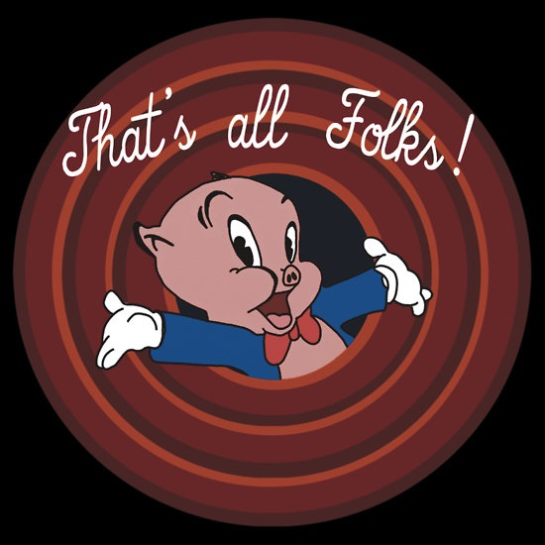


We appreciate your time and consideration!
Now that’s all folks!
Let’s make this a reality!

